Slide 1
9 pm EST Friday 6 Dec 2024

Slide 2

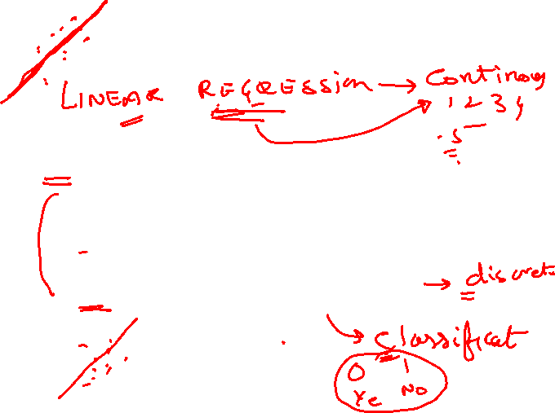
Logistic Regression
https://us06web.zoom.us/j/86163018904
https://us06web.zoom.us/j/86163018904

Slide 4
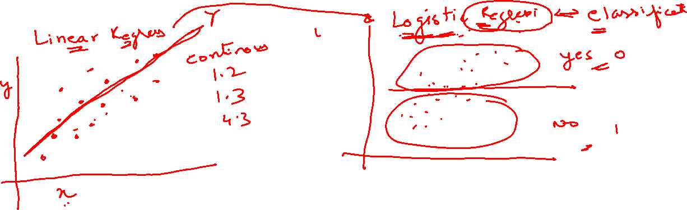

Slide 5

Logistic Regression Equation:
The underlying algorithm of Maximum Likelihood Estimation (MLE) determines the regression coefficient for the model that accurately predicts the probability of the binary dependent variable. The algorithm stops when the convergence criterion is met or maximum number of iterations are reached. Since the probability of any event lies between 0 and 1 (or 0% to 100%), when we plot the probability of dependent variable by independent factors, it will demonstrate an ‘S’ shape curve.

Slide 6
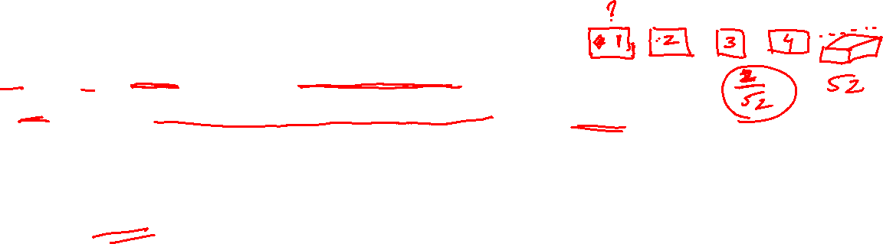
Logit Transformation
Logit Transformation is defined as follows-
Logit = Log (p/1-p) = log (probability of event happening/probability of event not happening) = log (Odds)
Logistic Regression is part of a larger class of algorithms known as GLM (Generlized Linear Model)

Slide 7
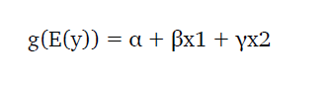
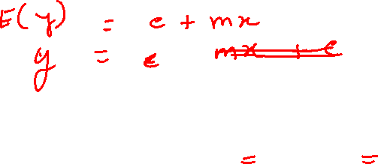
Generalized Linear Model (GLM)
Logistic Regression is part of a larger class of algorithms known as
Generalized Linear Model (GLM).
The fundamental equation of generalized linear model is:

Slide 8
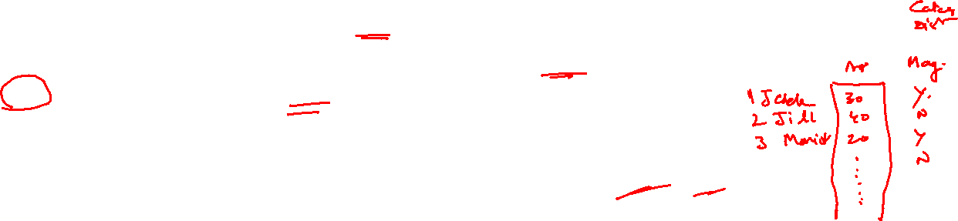
Case-Study Data
We are provided a sample of 1000 customers.
We need to predict the probability whether a customer of a Particular Age will buy (y) a particular magazine or
not.
As we’ve a categorical outcome variable, we’ll use logistic regression.

Slide 9
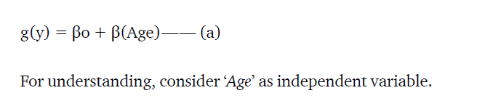
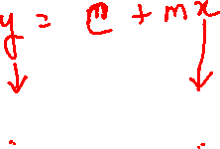
Linear to Logistic – (a)
To start with logistic regression, first write the simple linear regression equation with dependent variable enclosed in a link function:

Slide 10
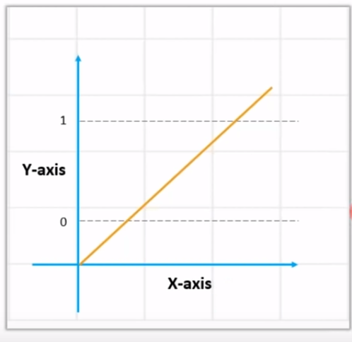
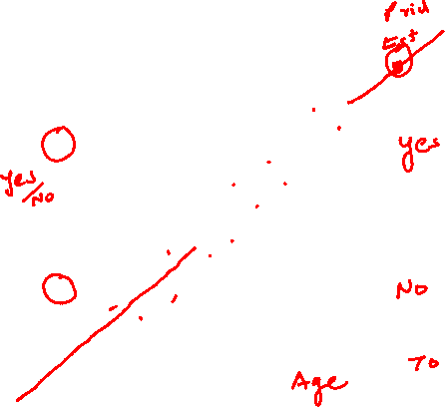
Linear Regression
+ infinity
- infinity

Slide 11
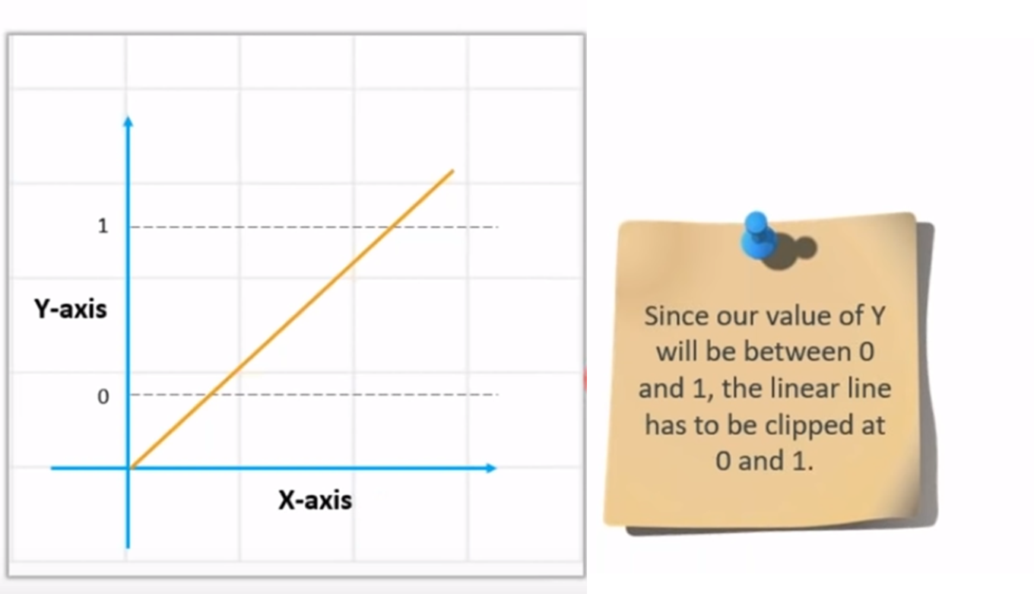
Linear regression equation: y = β0 + β1X1 + β2X2 …. + βnXn

Slide 12
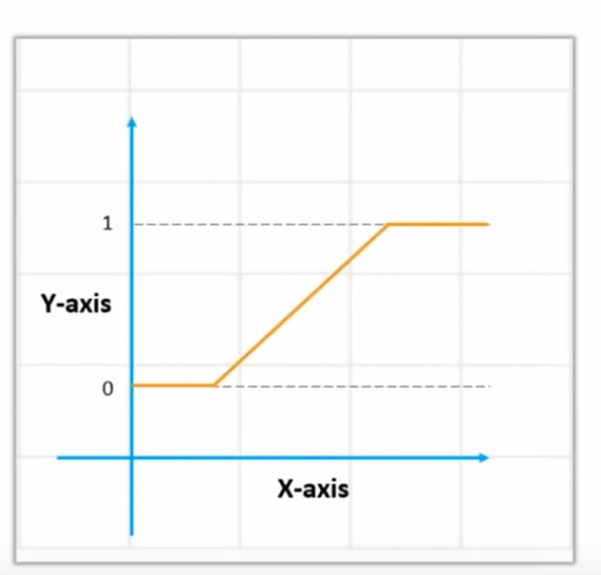
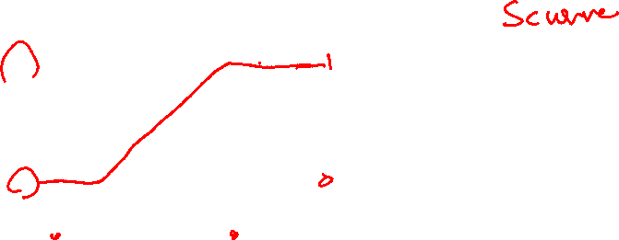
How to get the value of 0 and 1

Slide 13
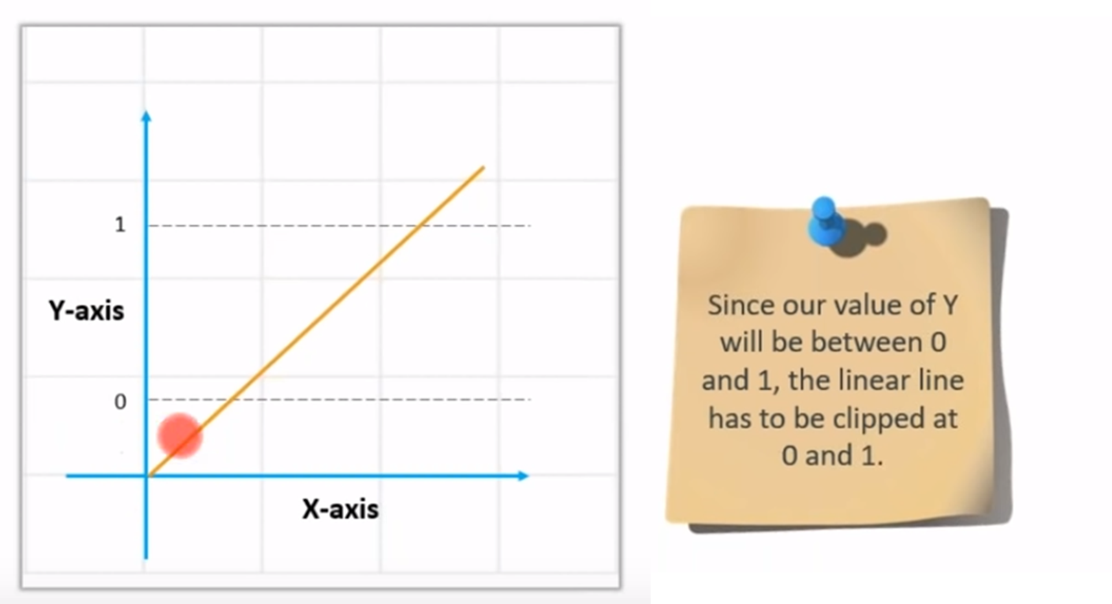
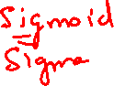
Value of Y – between 0 and 1

Slide 14
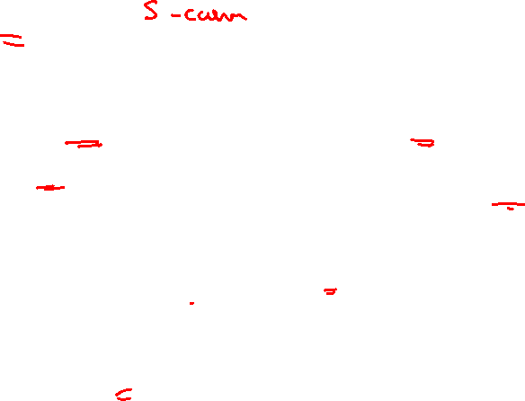
How to get the value of 0 and 1? Use Sigmoid
We Apply sigmoid function on the linear regression equation to get the S-curve so that it lies between 0 and 1
Sigmoid function: p = 1 / 1 + e^{-y}
A sigmoid function is a mathematical function/equation having a characteristic "S"-shaped curve or sigmoid curve.

Slide 15
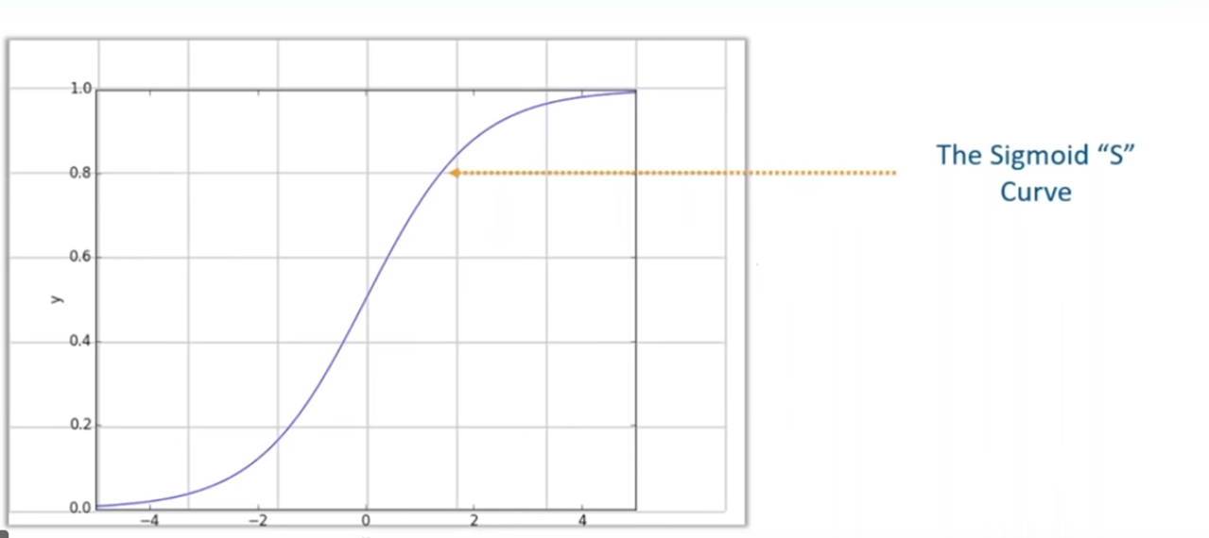
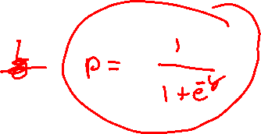
Sigmoid – S-curve

Slide 16
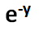
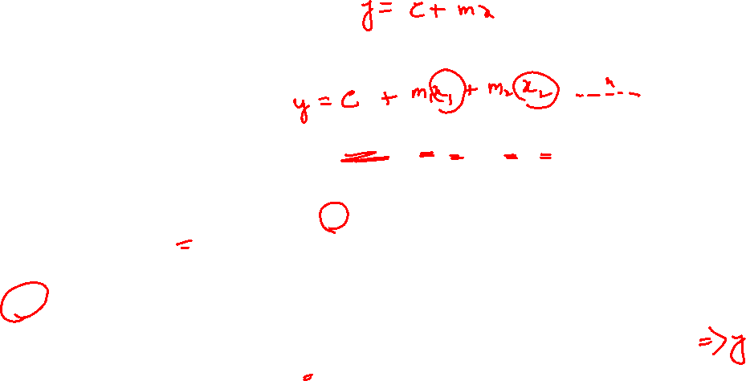
Convert Linear to Logistics
Linear regression equation: y = β0 + β1X1 + β2X2 …. + βnXn
Sigmoid function: p = 1 / 1 + e^{-y}
y is replaced
Logistic Regression equation: p = 1 / 1 + e^{-(β0 + β1X1 + β2X2 …. + βnXn)}

Slide 17
Logistic Regression Formula

Slide 18
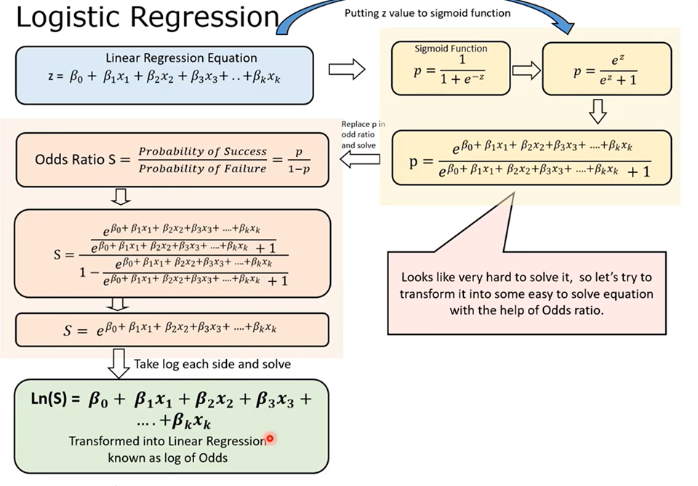
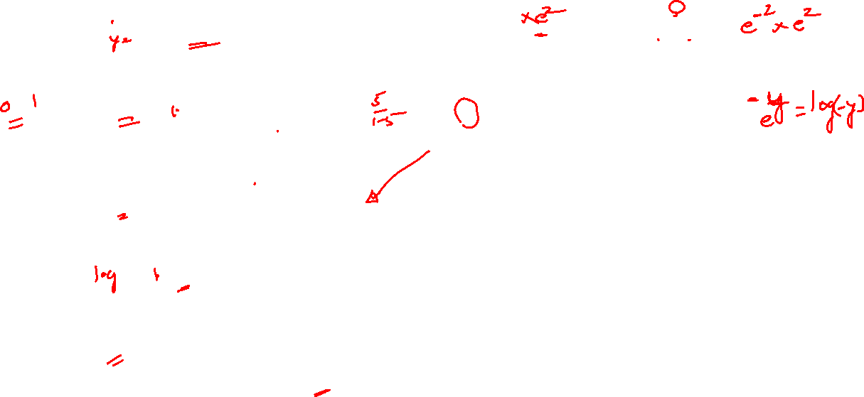
Notes:
https://ashutoshtripathi.com/2019/06/17/logistic-regression-with-an-example-in-r/
https://www.youtube.com/watch?time_continue=67&v=tnHLYnQV6bw&feature=emb_logo

Slide 19
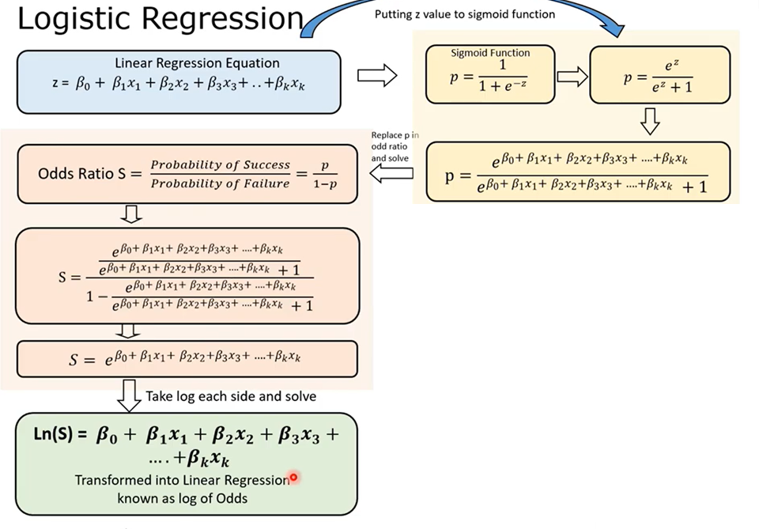

Slide 21
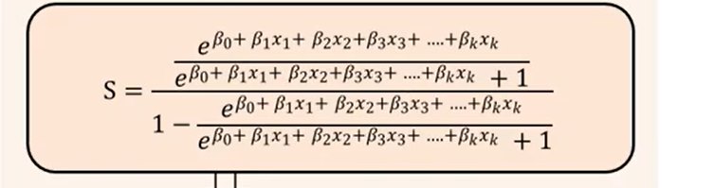
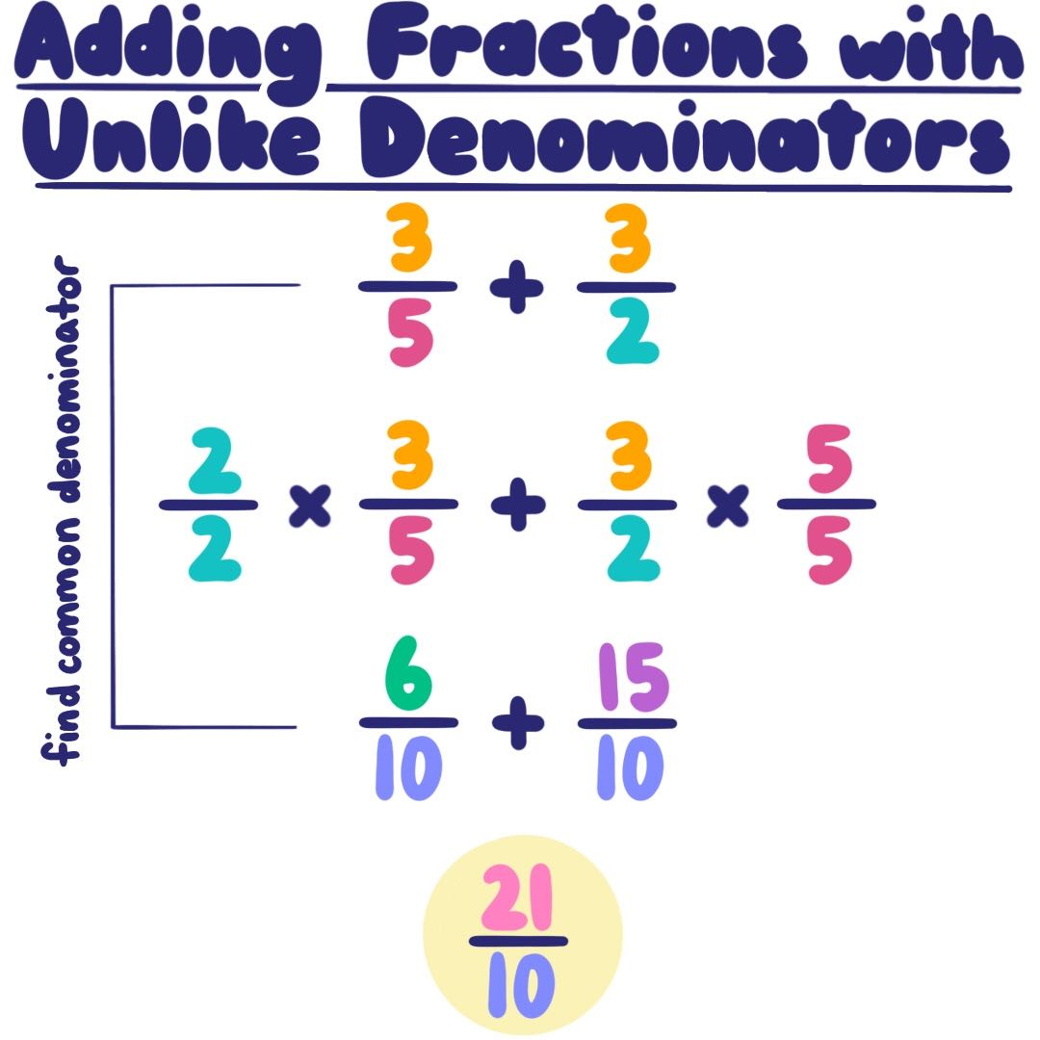
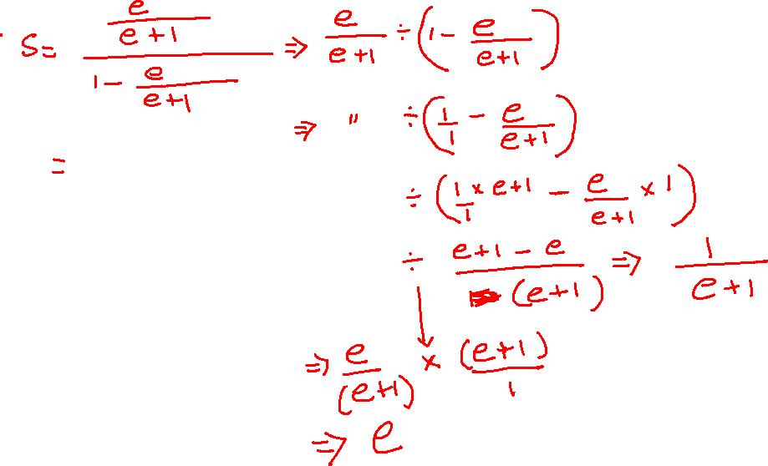

Slide 23
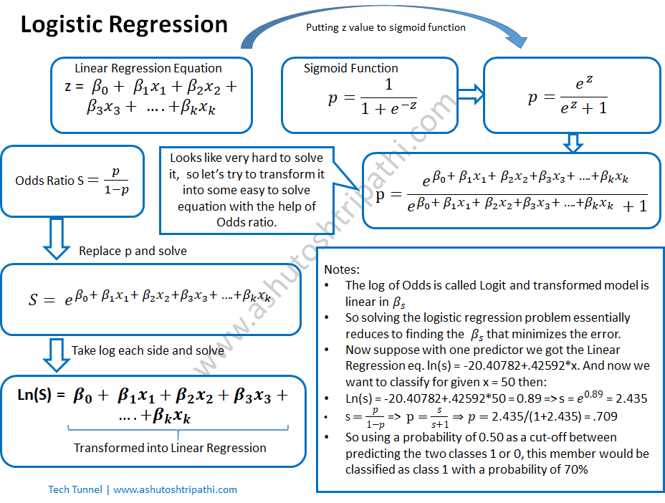

Slide 24
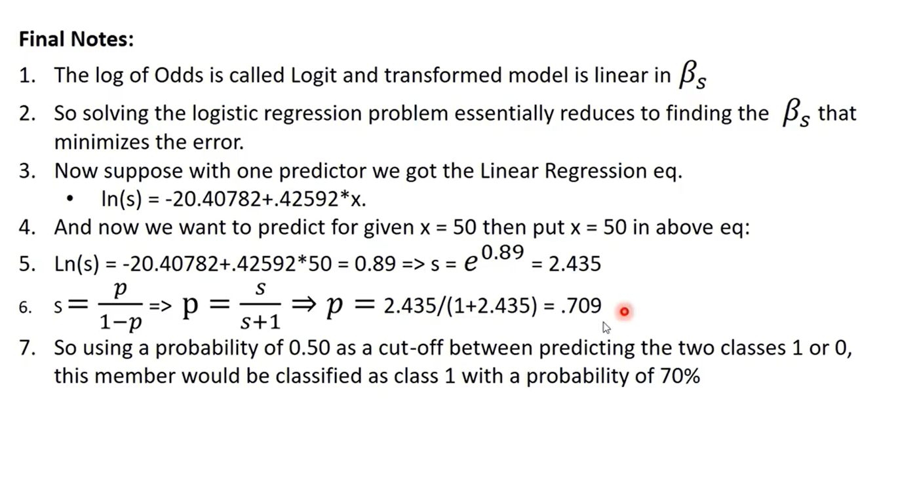
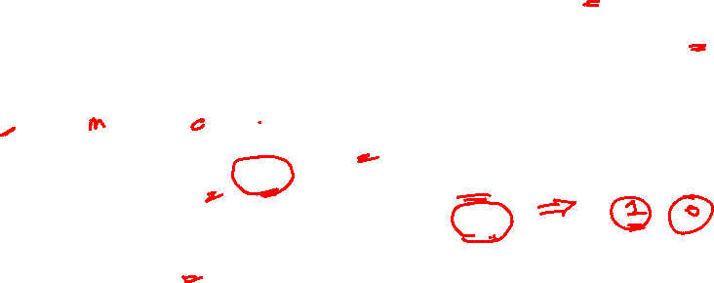
(S)This is odds ratio value
We want to find the probability (P) of occurrence, from the Odds ratio. So we put the value of S in the equation = p/1-p
Odds Ratio

Slide 25
Difference between Odds vs Log(odds)

Slide 26
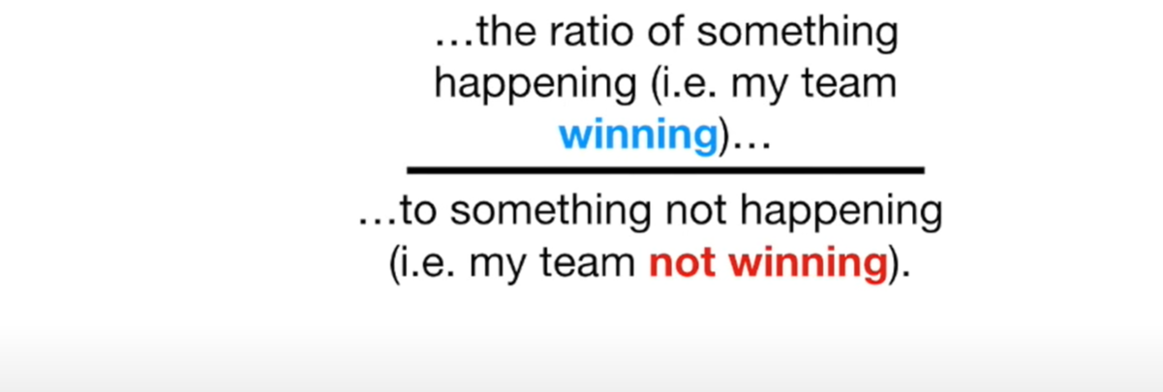
What are odds? =
Notes:
https://www.youtube.com/watch?v=8nm0G-1uJzA&list=RDCMUCtYLUTtgS3k1Fg4y5tAhLbw&index=2

Slide 27
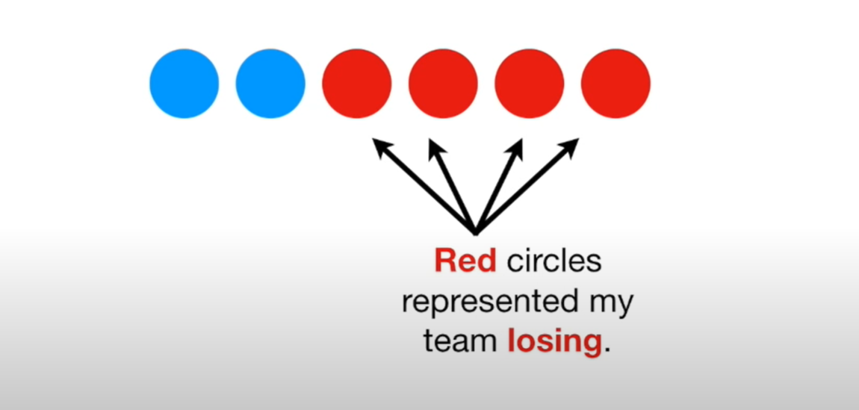
Blue circles represent Winning

Slide 28
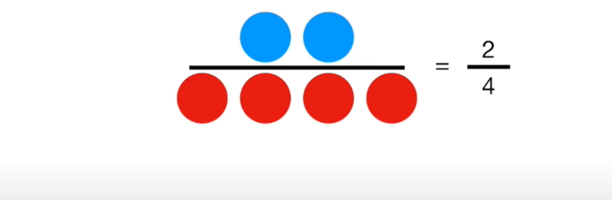
What are odds? =
Odds of Winning

Slide 29
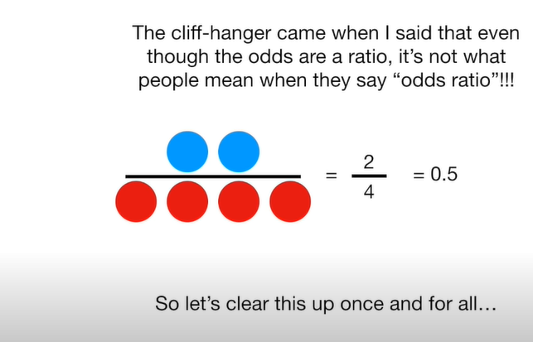
What are odds? =
Odds of Winning

Slide 30
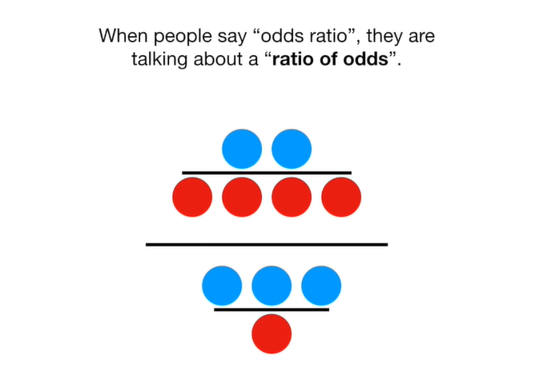
Odds of Winning for Example 1
Odds of Winning for Example 2
What are Odds Ratio? =
Here example 1 and Example 2 are, two different Games, and we are just using the Ratio of the Odds for each example

Slide 31
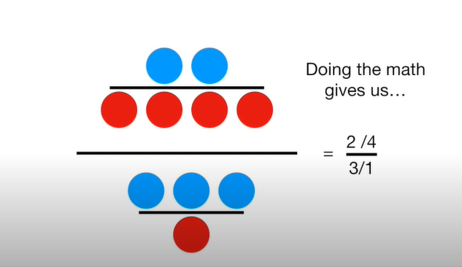

Slide 32
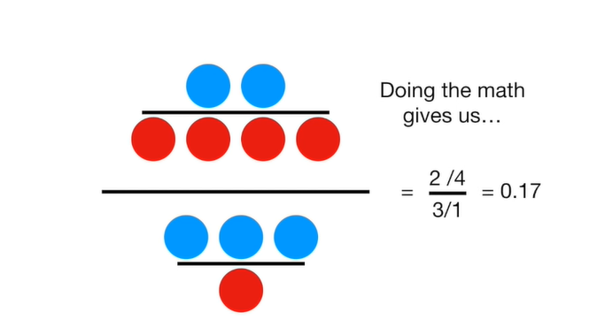

Slide 33
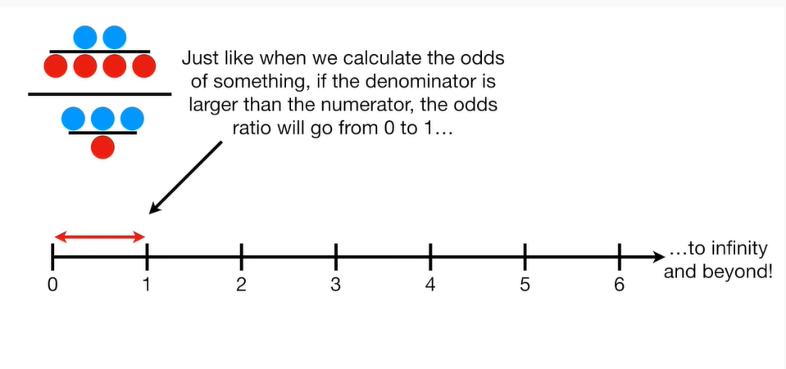
Odds of Winning for Example 1
Odds of Winning for Example 2

Slide 34
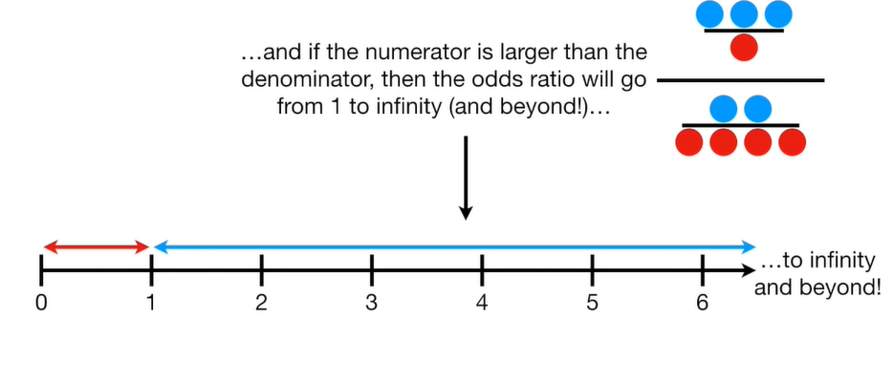
Odds of Winning for Example 2
Odds of Winning for Example 1

Slide 35
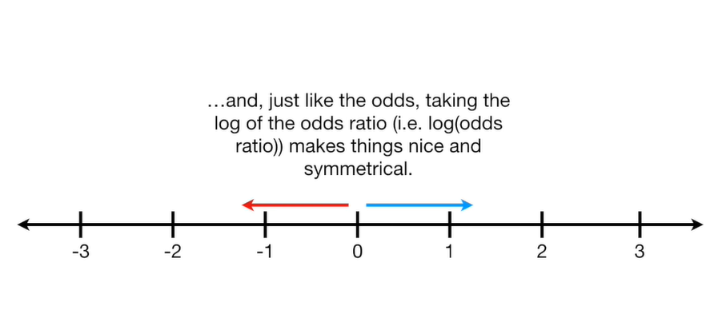
log
Odds of Winning for Example 1
Odds of Winning for Example 2

Slide 36
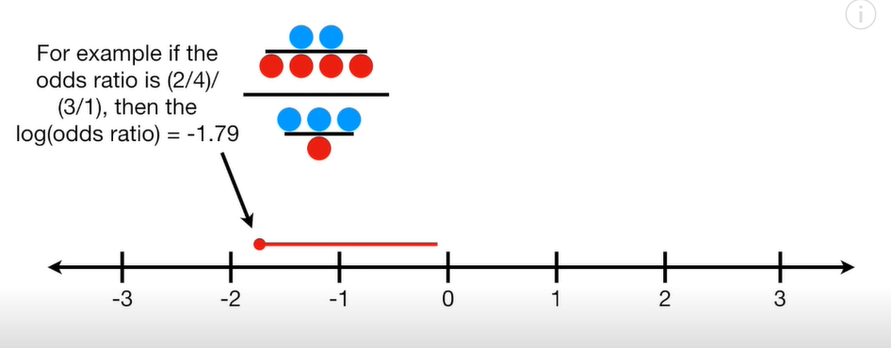

Slide 37
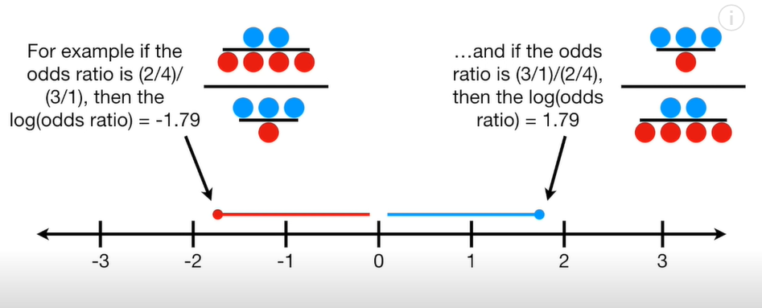

Slide 38
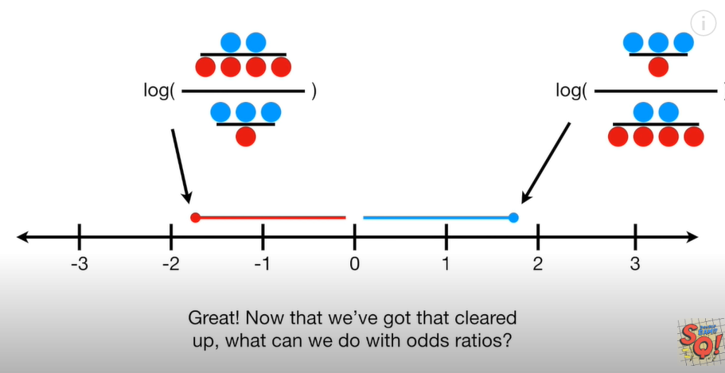

Slide 39
Example of how to use Odds Ratio
Before doing the example let us understand the Confusion Matrix

Slide 41
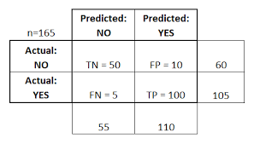

Slide 42
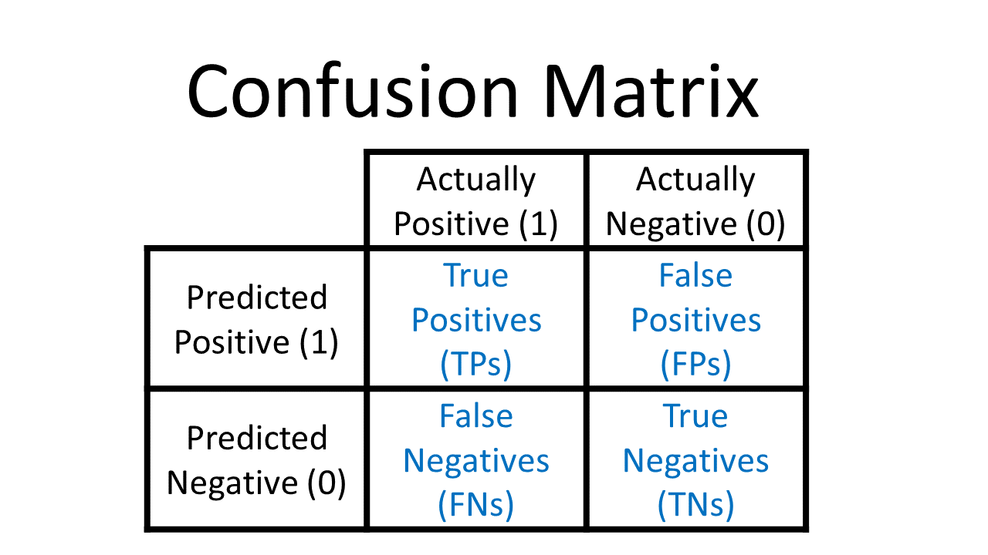
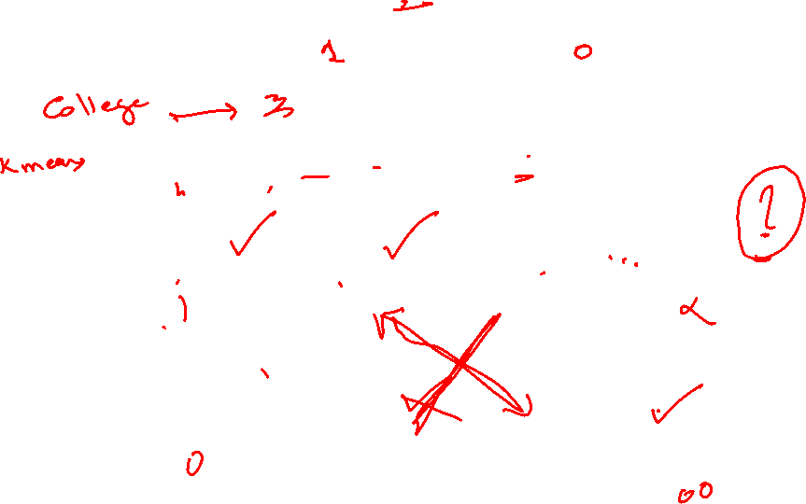

Slide 43
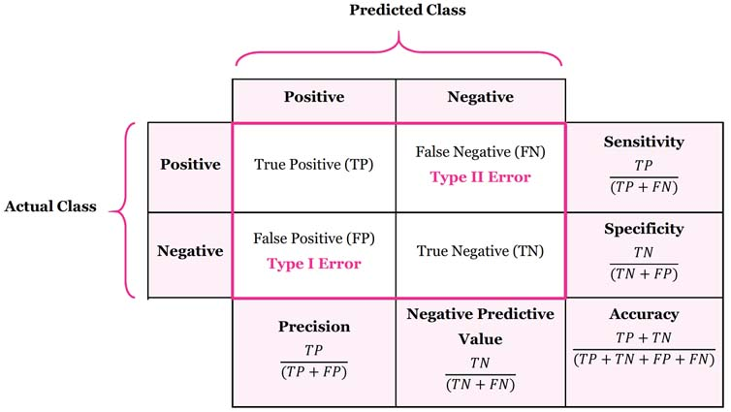

Slide 44
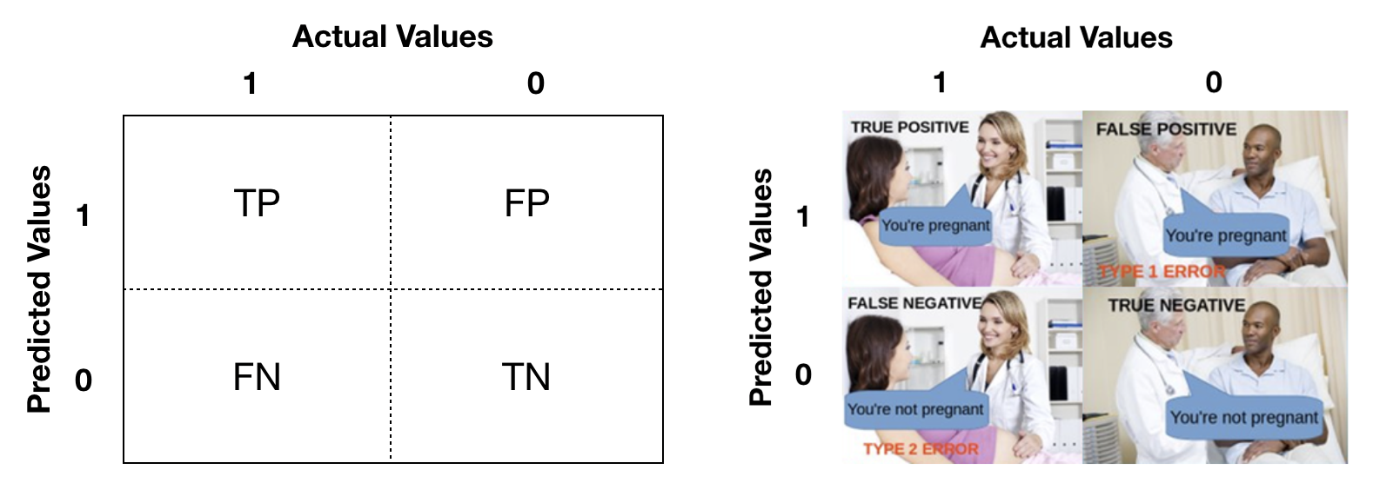

Slide 45
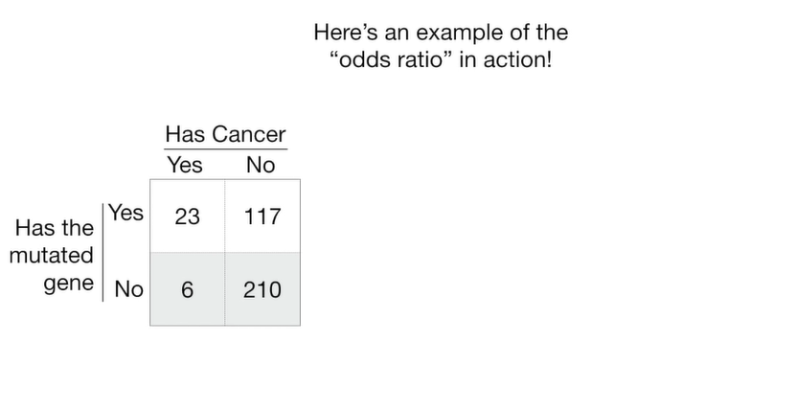
Find the relation between Mutated Genes and Persons having Cancer ?
Here we use Odds Ratio to find the relationship
What can we do with Odds Ratio?
Notes:
See the video:
https://www.youtube.com/watch?v=8nm0G-1uJzA
https://www.stata.com/support/faqs/statistics/odds-ratio-versus-odds/#:~:text=Englishwise%2C%20they%20are%20correct%3A%20it,ratio%20of%20two%20odds%20ratios.

Slide 46
Find the relation between Mutated Genes and Cancer
What can we do with Odds Ratio?
Total :356
140 have mutated gene
356
216 do not have mutated gene
29
have
cancer
327
Do not
have
cancer
356
Notes:
See the video:
https://www.youtube.com/watch?v=8nm0G-1uJzA
https://www.stata.com/support/faqs/statistics/odds-ratio-versus-odds/#:~:text=Englishwise%2C%20they%20are%20correct%3A%20it,ratio%20of%20two%20odds%20ratios.

Slide 47
What can we do with Odds Ratio?
Total :356
140 have mutated gene
356
216 do not have mutated gene
29
have
cancer
327
Do not
have
cancer
356
Notes:
See the video:
https://www.youtube.com/watch?v=8nm0G-1uJzA
https://www.stata.com/support/faqs/statistics/odds-ratio-versus-odds/#:~:text=Englishwise%2C%20they%20are%20correct%3A%20it,ratio%20of%20two%20odds%20ratios.

Slide 48
What can we do with Odds Ratio?
Total :356
140 have mutated gene
356
216 do not have mutated gene
29
have
cancer
327
Do not
have
cancer
356
Notes:
See the video:
https://www.youtube.com/watch?v=8nm0G-1uJzA
https://www.stata.com/support/faqs/statistics/odds-ratio-versus-odds/#:~:text=Englishwise%2C%20they%20are%20correct%3A%20it,ratio%20of%20two%20odds%20ratios.

Slide 49
What can we do with Odds Ratio?
Total :356
Given person has mutated gene, the odds that they have cancer are
23/117
Given person has mutated gene, the odds that they have cancer are
6/210
29
have
cancer
327
Do not
have
cancer
356
Notes:
See the video:
https://www.youtube.com/watch?v=8nm0G-1uJzA
https://www.stata.com/support/faqs/statistics/odds-ratio-versus-odds/#:~:text=Englishwise%2C%20they%20are%20correct%3A%20it,ratio%20of%20two%20odds%20ratios.

Slide 50
What can we do with Odds Ratio?
23/117
6/210
=6.88
29
have
cancer
327
Do not
have
cancer
Odds Ratio is : 6.88
If person has mutated gene then the odds are 6.88 times greater they will have cancer
Notes:
See the video:
https://www.youtube.com/watch?v=8nm0G-1uJzA
https://www.stata.com/support/faqs/statistics/odds-ratio-versus-odds/#:~:text=Englishwise%2C%20they%20are%20correct%3A%20it,ratio%20of%20two%20odds%20ratios.

Slide 51
What can we do with Odds Ratio?
We can use the odds ratio to find the relation ship between mutated gene and cancer. If there is mutated gene is the odds higher that person will have cancer.
Odds Ratio is :
23/117//6/210 = 0.2/0.03=6.88
If person has mutated gene then the odds are 6.88 times greater they will have cancere
Log(odds)Ratio
Log (6.88) =1.93
29
have
cancer
23/117
6/210 = 0.2/0.03=6.88
327
Do not
have
cancer
Notes:
See the video:
https://www.youtube.com/watch?v=8nm0G-1uJzA
https://www.stata.com/support/faqs/statistics/odds-ratio-versus-odds/#:~:text=Englishwise%2C%20they%20are%20correct%3A%20it,ratio%20of%20two%20odds%20ratios.

Slide 52
What can we do with Odds Ratio?
Total :356
140 have mutated gene
216 do not have mutated gene
We can use the odds ratio to find the relation ship between mutated gene and cancer. If there is mutated gene is the odds higher that person will have cancer.
Given that a person has a mutated gene , that odds that they have cancer are:
23/117
Given a person does not have a mutated gene, the odds that they have cancer:
6/210
Odds Ratio is :
23/117//6/210 = 0.2/0.03=6.88
Log(odds)Ratio
Log (6.88) =1.93
29 have cancer
327
Do not
have
cancer
Odds ratio
and the log(odds ratio) is
Like R-square.
It tells us the relationship
Between the mutated gene
And cancer. Large values mutated genes is a good predictor of cancer. Small values the mutated Genes is not a Good Predictor of cancer.
Notes:
See the video:
https://www.youtube.com/watch?v=8nm0G-1uJzA
https://www.stata.com/support/faqs/statistics/odds-ratio-versus-odds/#:~:text=Englishwise%2C%20they%20are%20correct%3A%20it,ratio%20of%20two%20odds%20ratios.

Slide 53
What can we do with Odds Ratio?
Total :356
140 have mutated gene
216 do not have mutated gene
Given that a person has a mutated gene , that odds that they have cancer are:
23/117
29
have
cancer
327
Do not
have
cancer

Slide 54
What can we do with Odds Ratio?
Total :356
140 have mutated gene
216 do not have mutated gene
We can use the odds ratio to find the relation ship between mutated gene and cancer
29
have
cancer
327
Do not
have
cancer

Slide 55
What can we do with Odds Ratio?
Total :356
140 have mutated gene
216 do not have mutated gene
We can use the odds ratio to find the relation ship between mutated gene and cancer
29
have
cancer
327
Do not
have
cancer

Slide 56
What can we do with Odds Ratio?
Total :356
140 have mutated gene
216 do not have mutated gene
We can use the odds ratio to find the relation ship between mutated gene and cancer
29
have
cancer
327
Do not
have
cancer

Slide 57
